Slide 1
Best Neighborhood for an Szechuan Restaurant

Slide 2
Introduction
In this hypothetical scenario, a successful Chinese restaurant is looking to expand their business into a new city in the United States.
This Szechuan restaurant was opened up in 2013 at a college town and sooner become one of most popular Chinese restaurants in town. Recently, the owners would like to expand the family business to West Coast. Los Angeles, California is the first choice.
The owners had conducted market research and is confident that the taste of their restaurant would be the dominator in town. However, not knowing the city well, the owners have difficulties to identify the best neighborhood to open their business.

Slide 3
Data
Postcodes, latitude and longitude data scrapped from https://www.geonames.org/postalcode-search.html?q=Pittsburgh%2C+Pennsylvania&country=US
Median household income data was taken from U.S. Census Bureau. http://data.census.gov.
Foursquare API

Slide 4
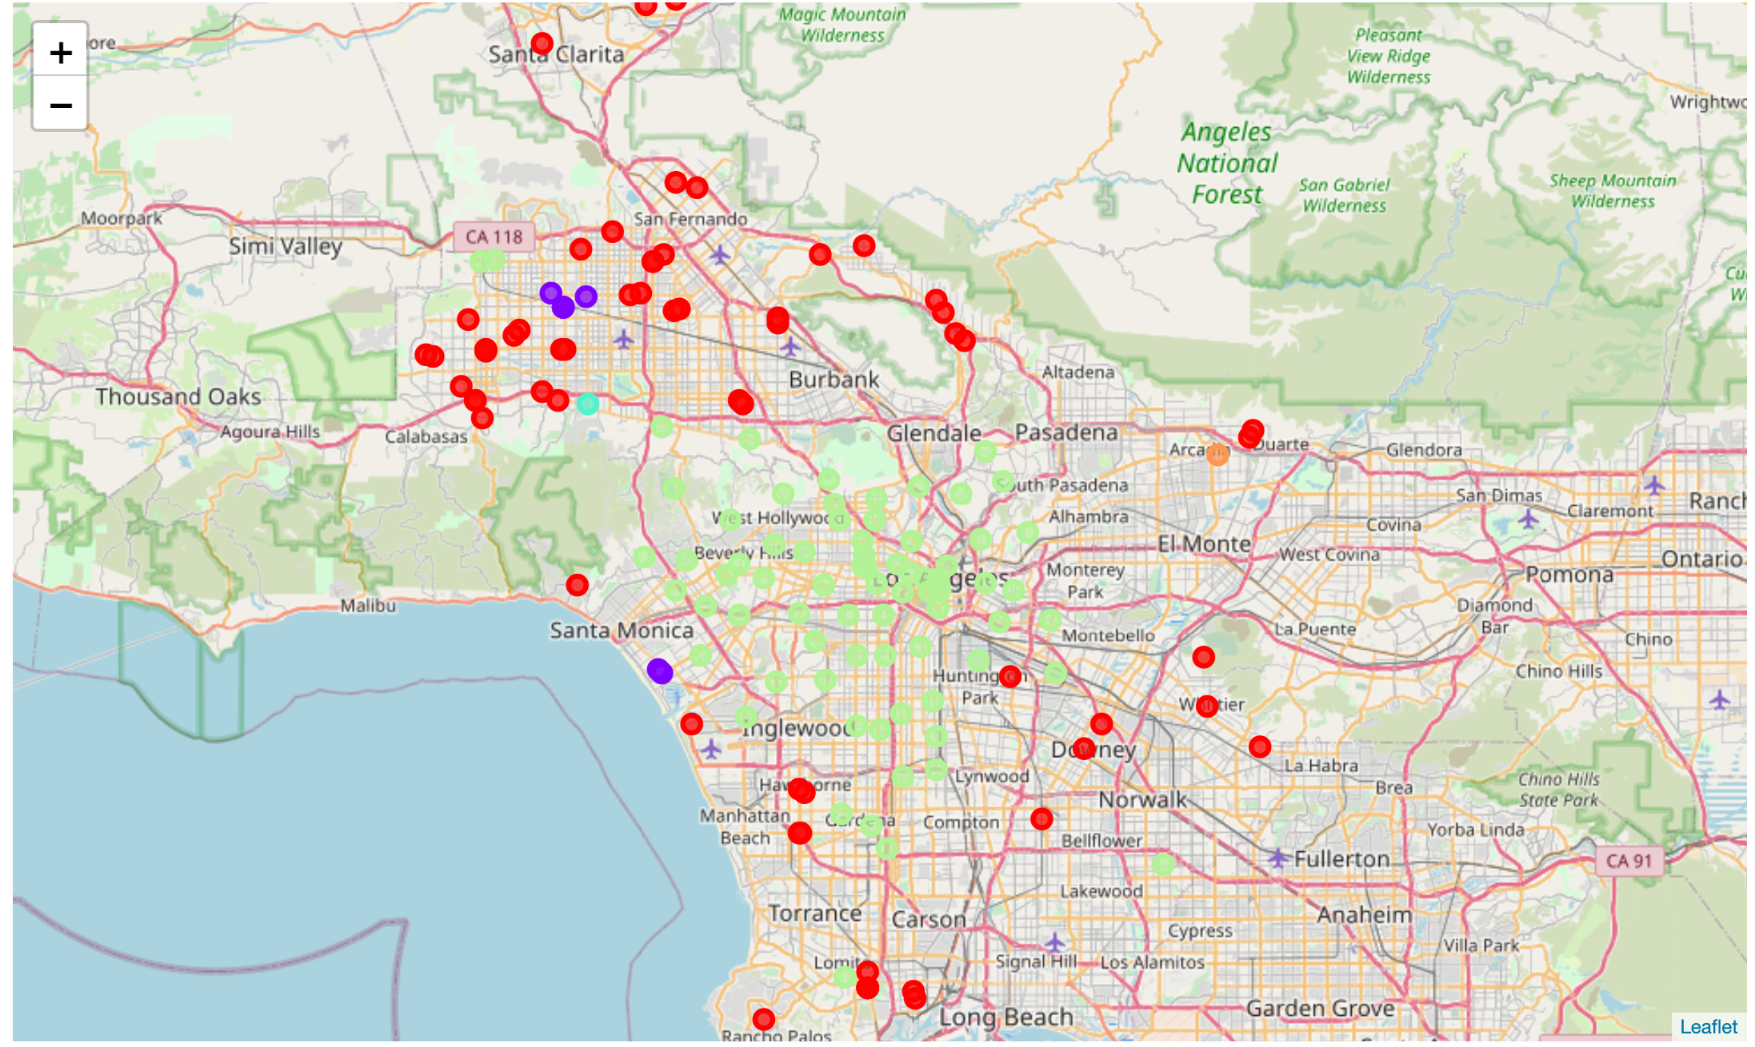
K-means clustering

Slide 5
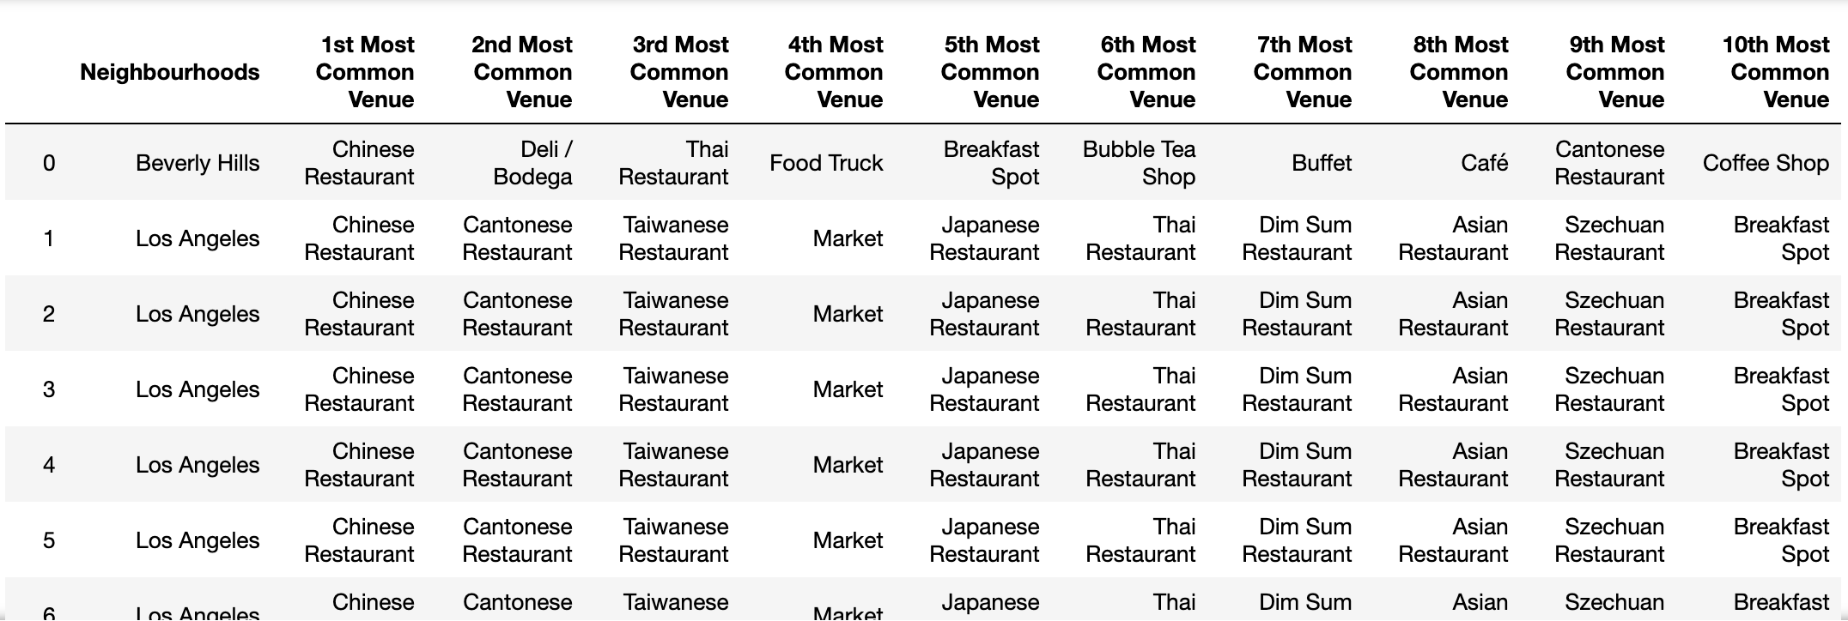
K-means clustering

Slide 6
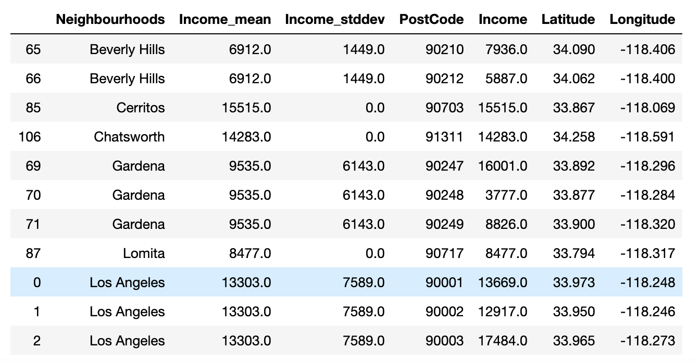
Household Income of target Neighborhoods

Slide 7
Conclusion
Using Foursquare data, the search was reduced to a cluster of six areas: Beverly Hills, Los Angeles, Chatsworth, Sherman Oaks, Studio City, Gardena, Cerritos and Lomita.
Based on the findings of this investigation I would recommend the client consider either the neighborhoods of Chatsworth, Sherman Oaks, Studio City or Cerritos as possible locations for her new restaurant.

